Slide 1
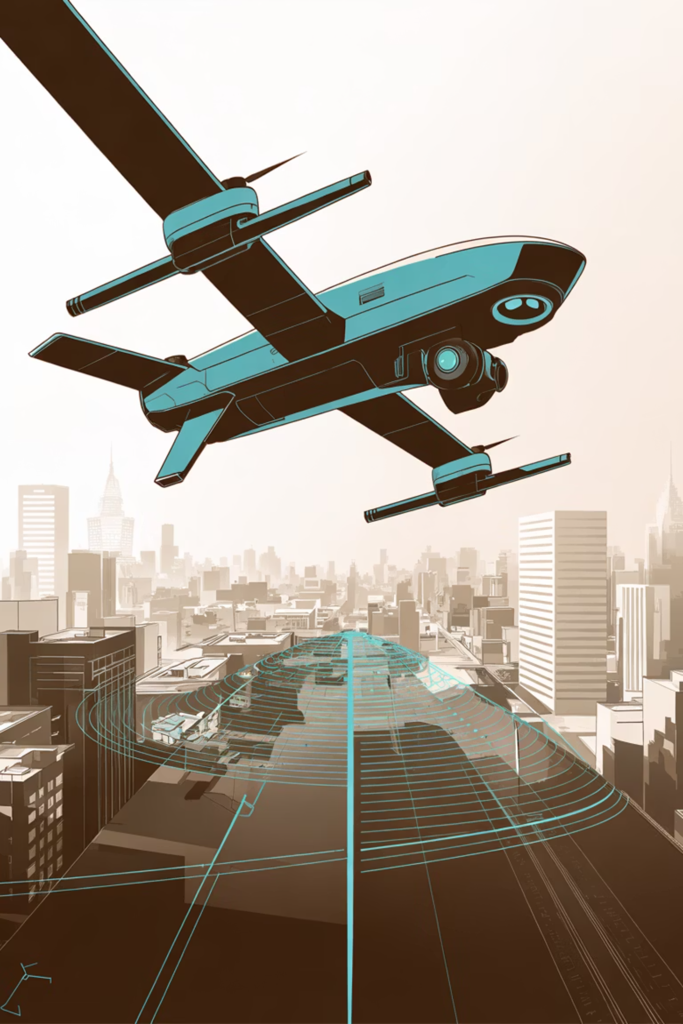

Capstone Final Review
XAI-UAV: Explainable AI for Robust Object Detection in Tactical UAV
Capstone ID: 20250561
Name | Registration Number
Kana Hakshay Reddy | 22BCE9807
Konakalla Rishitha | 22BCE7331
Appala Pranav Sai | 22BCE7558
Department of Artificial Intelligence and Machine Learning,
VIT-AP, Amaravati, India

Slide 2

Problems in Object Detection in UAVs
Modern AI-powered UAV systems face a critical challenge: achieving high detection accuracy while maintaining transparency, efficiency, and operational reliability in resource-constrained environments.
The Accuracy-Transparency Trade-off
Resource Constraints on Edge Devices
Aerial Imagery Challenges
High-altitude UAV imagery presents unique obstacles: low resolution, small objects appearing as tiny pixels, cluttered urban backgrounds, occlusions, and variable lighting conditions all demand specialized explainability approaches.
YOLO detectors achieve impressive accuracy but operate as opaque black boxes. In tactical and defense applications, operators must validate AI decisions in real-time, trust is non-negotiable, and regulatory compliance demands accountability.
UAVs operate under severe computational limits. The Jetson Nano provides just 8GB RAM and ~472 GFLOPS. Traditional explainability methods require 71 seconds per image, prohibitively slow when milliseconds matter for battery life and mission success.
Current Limitations:
0.3641s inference time (too slow for real-time)
44 MB model size

Slide 3






Objectives: Balancing the Three Pillars
Integrated Explainability
Lightweight Detection Models
Embed Grad-CAM techniques
Interpretable model decisions
Support human-in-the-loop workflows
VisDrone dataset (10,209 images)
Train YOLO for UAV imagery
Optimize for resource-constrained platforms
Robustness and Efficiency
Operational constraint performance
Pruning reduces compute overhead
Reliability across diverse conditions

Slide 4
Key Differentiators: What Sets Us Apart from Past Work
1
2
First Systematic Integration
BN-Based Pruning for XAI
XAI + BN-pruning + UAV framework combined
Uses batch normalization scaling factors
Prior work addressed these separately
Identifies non-critical filters systematically
Novel system-level integration
Maintains explanation quality during compression
3
4
Aerial Imagery-Specific Explainability
End-to-End Deployable Framework
Grad-CAM adapted for high-altitude, small-object detection
Working software module (not just on paper)
Handles low-resolution aerial imagery
Runs on Low-power edge devices
Trained on VisDrone dataset
Ready for operational integration

Slide 5
Industry-Standard Technology Stack
Detection Framework
Explainability
YOLOv8 (Ultralytics)
Grad-CAM
State-of-the-art real-time object detector
Open-source, peer-reviewed architecture
Production-ready with extensive validation
Class-discriminative visual explanations
Published, validated interpretability method
Gradient-based activation mapping
Pruning Methodology
Benchmark Dataset
BN-Based Pruning
VisDrone Challenge
Deep Compression framework implementation
Systematic, data-driven channel selection
Reproducible compression pipeline
10,209 high-resolution UAV images
Diverse object categories and scenarios
Standard evaluation protocol

Slide 6



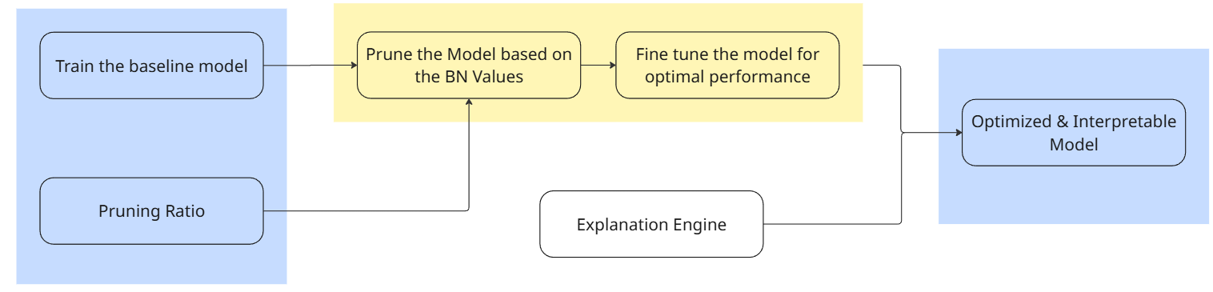

The XAI-UAV System Pipeline
Training Phase
Optimization Phase
Deployment Phase
VisDrone Datasets
BN-Based Pruning Analysis
Real-time Operation
YOLOv8 training with BN layers intact
Identify low-impact filters and remove
UAV camera input
Baseline: 0.3641s inference, 44MB
Fine-tuning on VisDrone
YOLOv8-Pruned detection
Result: 0.1188s inference, 22MB
Grad-CAM explanation generation
Output
Inputs
Why BN-Based Pruning?
Uses batch normalization scaling factors (γ) as importance indicator
Channels with |γ| ≈ 0 contribute minimally to output
Key Insight: We don't randomly remove parameters. We analyze every BN layer's scaling factors to identify genuinely redundant channels, then fine-tune for adaptation.
Data-driven, systematic approach
Maintains model interpretability through structured pruning

Slide 7

Key Achievements
Inference Time
0.364s
0.119s
3.06×
Original YOLOv8
Pruned YOLOv8
Speedup
2.7 frames per second
8.4 frames per second
Real-time Speed
With accuracy being Comparable to the Latest YOLO Models
Operational Impact
Longer Battery Life
Less compute = less power consumption
More Targets Processed
Increased throughput in mission duration
Edge Deployment Feasible
Real-time performance on resource-constrained hardware

Slide 8
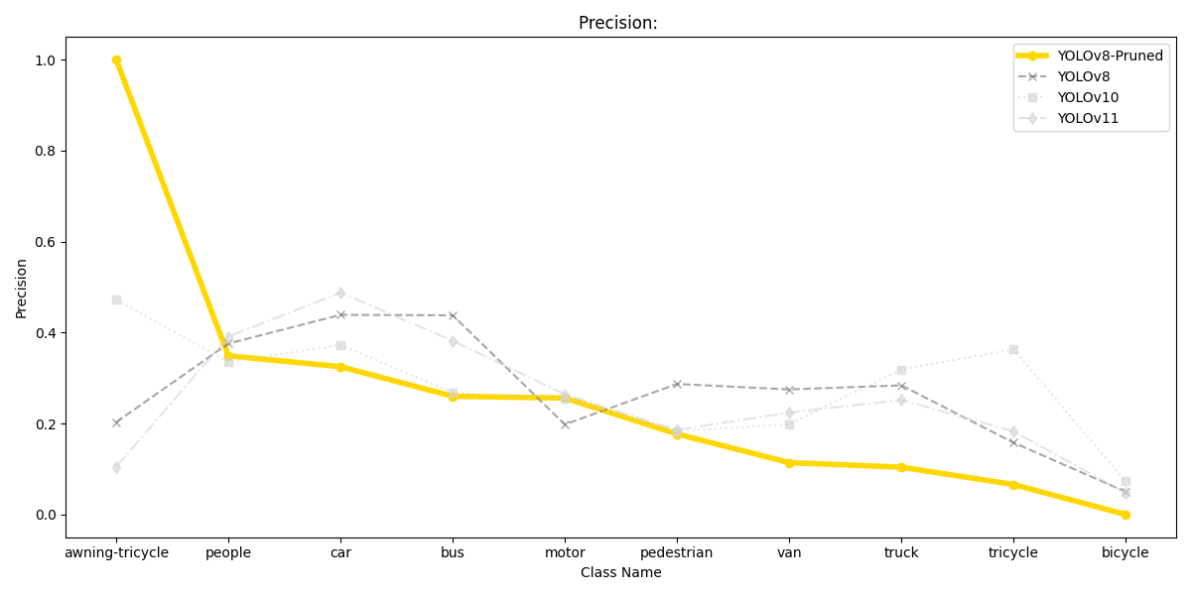
Results
Precision Comparison

Slide 9
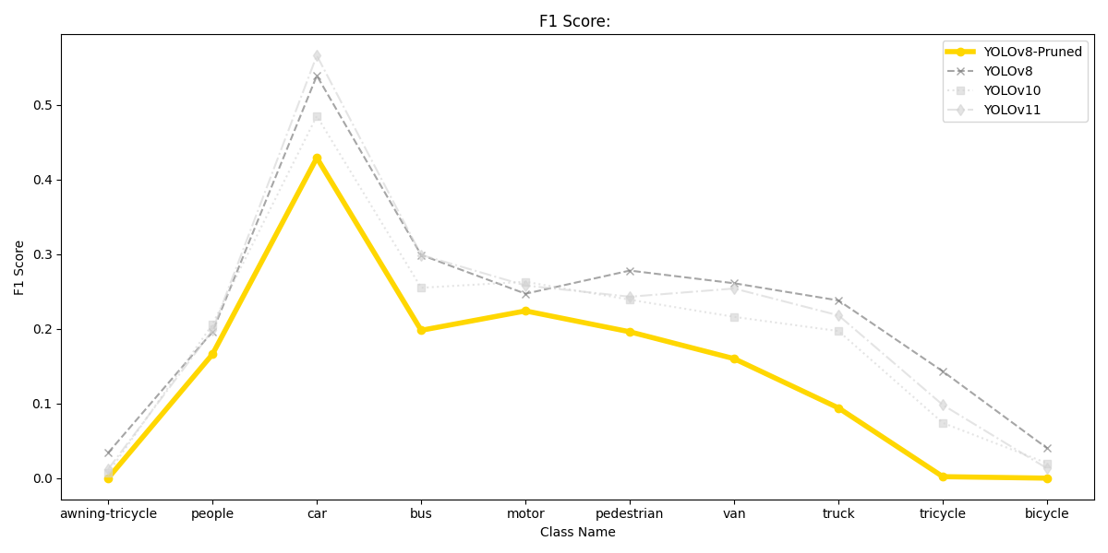
Results
F1 – Score Comparison

Slide 10
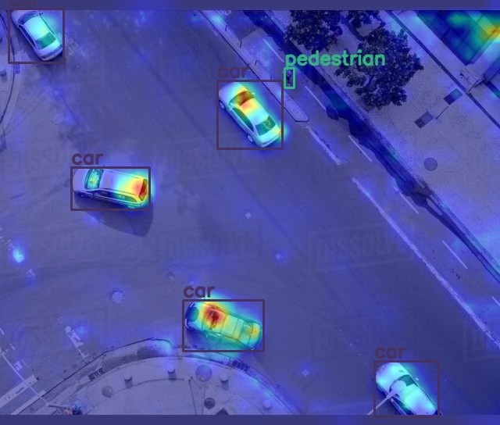
Explanation Output
Visual explanations showing what the model "sees" during detection
Heatmap Color Key
Red / Yellow Regions
Most critical for classification decision
Green Regions
Medium impact on model output
Blue Regions
Minimal impact on model output

Slide 11
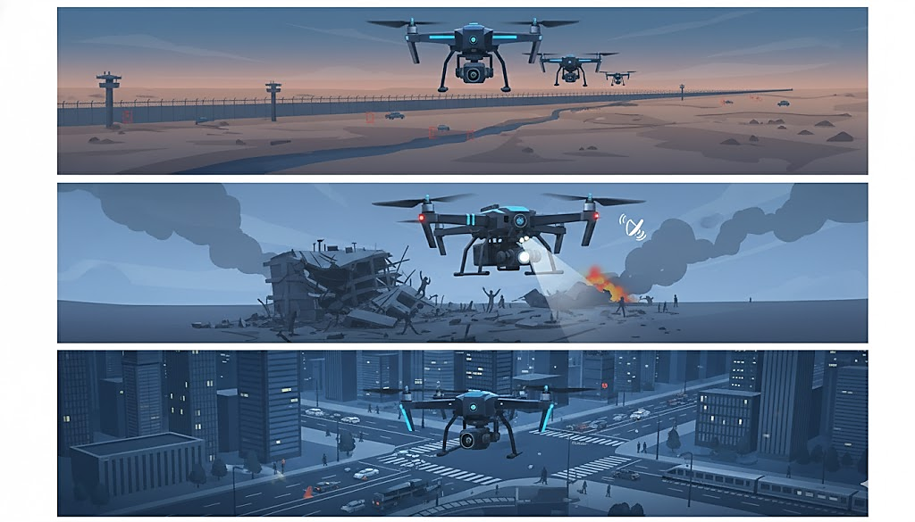
Applications
Our pruned YOLOv8 model is optimized for real-world applications, offering robust and reliable performance in critical surveillance and response missions.
Primary Use Case: Tactical UAV Surveillance
Runs efficiently on NVIDIA Jetson Nano/Orin edge devices
Achieves real-time object detection at 8.4 frames per second on local
Integrates Grad-CAM for in-line, transparent AI decision explanations
Designed for operational feasibility and reliability in the field
Leverages 5-10 UAVs with Jetson Nano for autonomous patrols
Disaster Response
Deploys search-and-rescue UAVs to locate survivors in challenging terrain
Detects unauthorized vehicles and movements with high accuracy
Achieves 67% battery life extension vs. original models
Urban Monitoring
Conducts traffic analysis and infrastructure inspection
Processes data in real-time on local ground stations
Explainable outputs facilitate swift anomaly investigation and reporting
Quickly assesses damage in hazardous environments
Explainable outputs build operator trust for faster, informed decisions
Border Surveillance

Slide 12




Conclusion and Future Scope
Our XAI-UAV framework successfully delivers explainable, efficient, and robust object detection for tactical drone operations.
3x Speed, Edge-Ready
Transparent Decisions
Pruned YOLOv8 achieves real-time 8.4 FPS on Jetson Nano, extending UAV battery life by 67% for critical missions.
Integrated Grad-CAM provides crucial visual explanations, empowering operators to validate AI reasoning in real-time.
Robust & Deployable
The end-to-end framework maintains reliability across diverse UAV scenarios, ready for immediate operational integration.
Future Outlook: Continuous research into multi-modal fusion, federated learning, and YOLOv11 migration will further enhance capabilities.

Slide 13
References

Slide 14

Thank You!

